Slide 1



Sneaker Data Analysis
Group 3

Slide 2


Team Members
Sana Naseem
Sonali Jammichedu
Neha Parveen Mohammed
Sonjeet Kaur
Vennila

Slide 3

Introduction
The sneaker market is expanding through a fusion of fashion, tech, and cultural trends, driven by data analysis.
In-depth analysis of a curated sneaker dataset reveals consumer behavior and market tendencies.
The study identifies key patterns in style, color, and brand preferences to forecast future trends.
The analysis's scope is subject to data availability and may focus on specific regions or market segments.
Data visualization is essential in distilling complex information and providing clear insights for decision-makers.

Slide 4
Objectives
Cleanse the dataset by eliminating irrelevant data and missing values.
1
Conduct initial data exploration to uncover patterns, anomalies, and correlations within the sneaker market.
2
Engineer new data points, such as sneaker age, and pinpoint key factors affecting sneaker pricing.
3
Build predictive models for pricing and group sneakers by characteristics to understand market performance.
4
Utilize data visualizations to illustrate pricing patterns and forecast profitability in various sneaker segments.
5

Slide 5
Technical Analysis
Analyzed a subset of 500,000 records from a large sneaker dataset containing 14 million entries.
Began with a Random Forest model, then shifted to use it for feature identification due to initial high error rates.
Applied standardization and normalization to enhance model precision.
Employed a Feed Forward Neural Network to forecast sneaker prices.

Slide 6
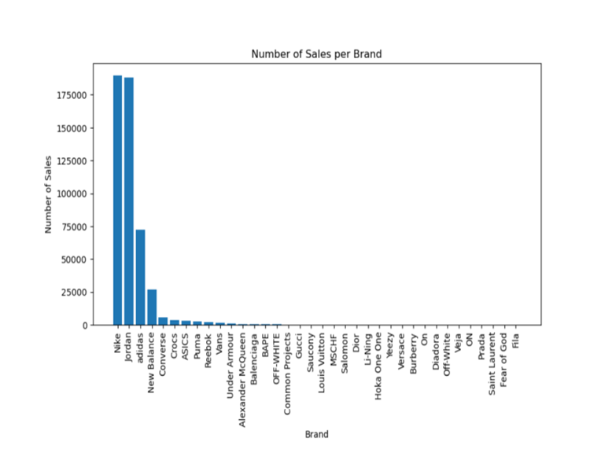
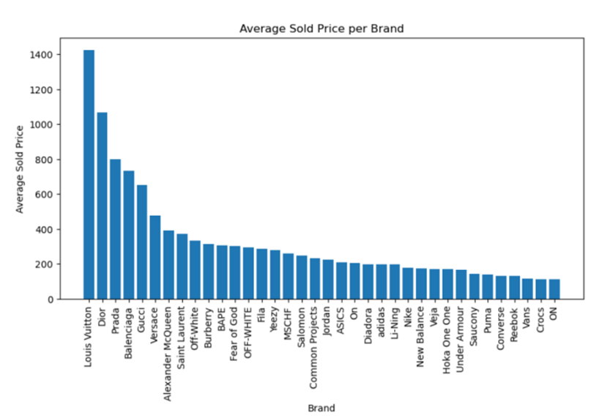
Data Analysis

Slide 7
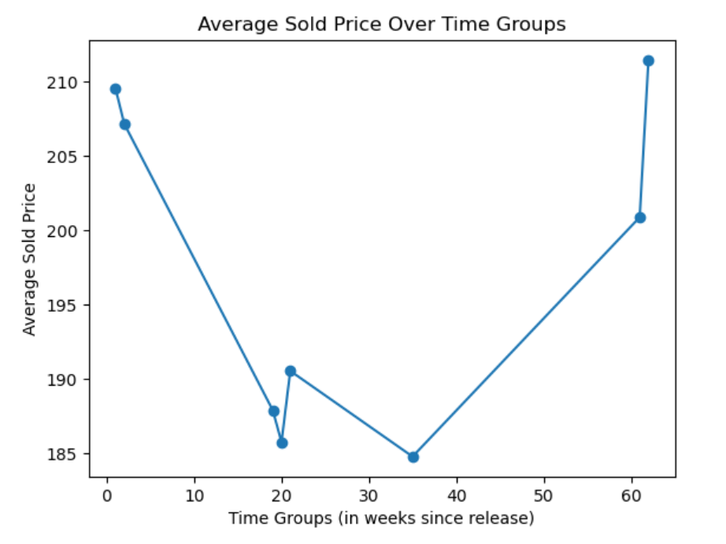
DATA ANAlysis
Average price per week for a single SKU.

Slide 8
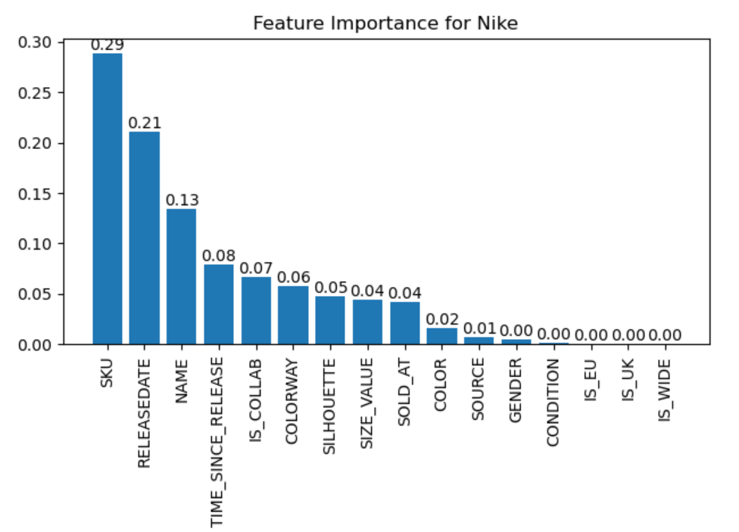
Feature Importance
We applied the random forest algorithm to identify key features influencing sneaker prices.
This helps in simplifying the model, reducing overfitting, and improving performance.
We experimented by selecting unique brands and then applied the model to our data.

Slide 9
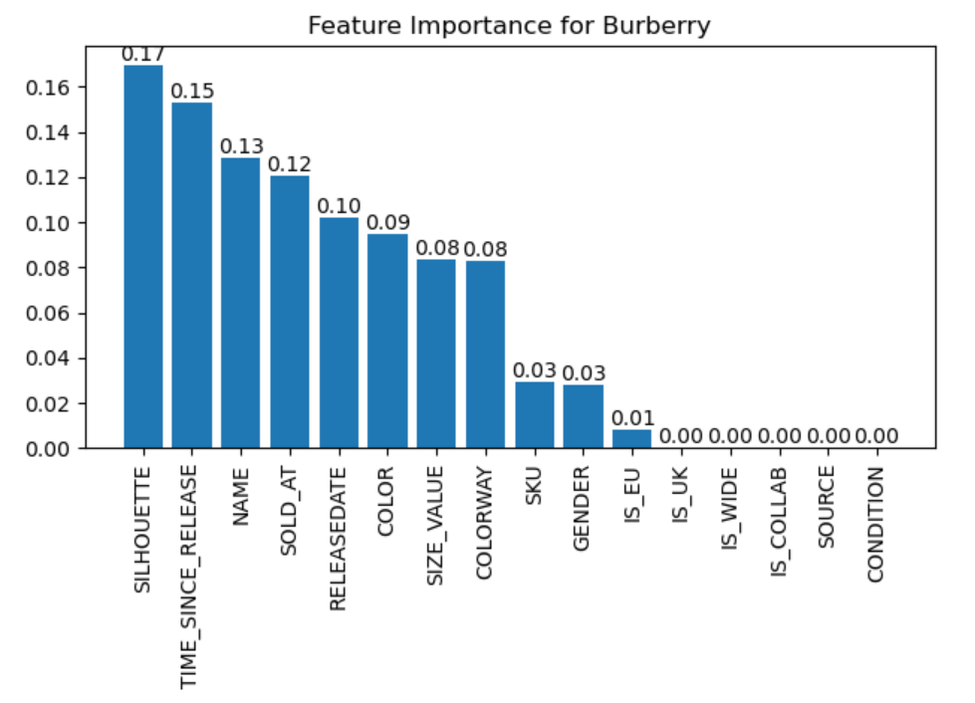
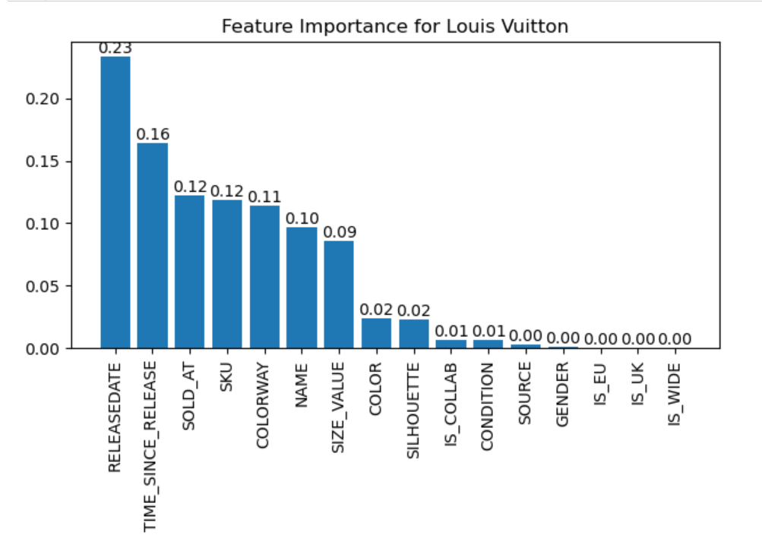
Feature Importance

Slide 10
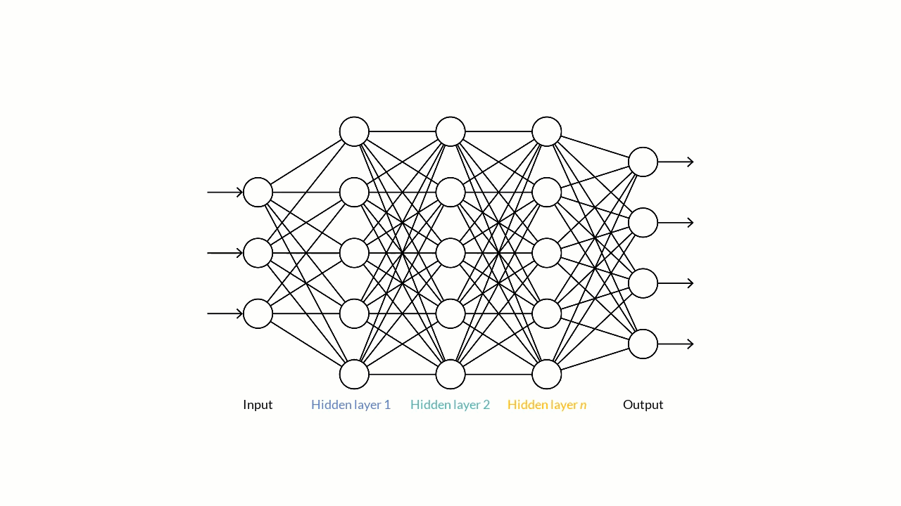
Feed Forward Neural Network
Our model features a multi-layered Feedforward Neural Network.
We used StandardScaler to transform data. Mean = 0; Standard deviation = 1.
We used ReLU activation for hidden layers and a linear activation for the output layer.
80 %
20%
Mean Squared error: 169.46543506586679
Training
Validation
Testing

Slide 11
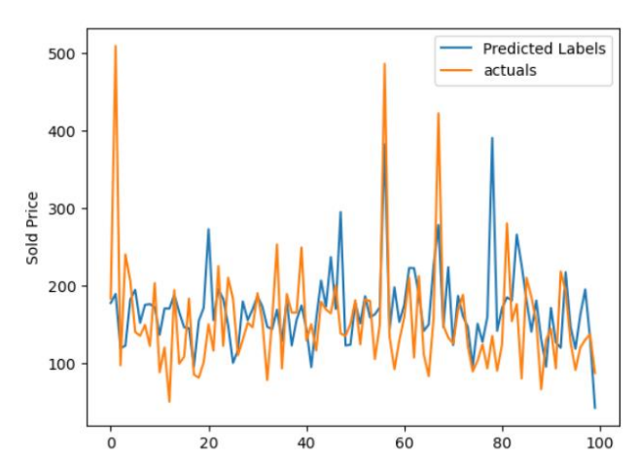
Results

Slide 12
Challenges Faced
Encountered challenges in transferring data directly from the S3 bucket to AWS SageMaker.
Struggled with choosing an effective prediction model due to significant error rates.
Ran into difficulties with feature encoding.
Experienced problems during data standardization and reverting to original values.

Slide 13

Conclusion
Our high MSE reveals the complexity of neural network price prediction and guides our learning.
The results show us that we need to improve how we analyze the data and build our model to get better predictions.
We view these results as an opportunity to enhance our model through further research and experimentation.

Slide 14
References & Citations
Raditya, D., & Hanafiah, N. (2021). Predicting sneaker resale prices using machine learning. Procedia computer science, 179, 533-540.
Nunno, lucas. (2014). “Stock market price prediction using linear and polynomial regression models.” 1–6
Coulston john w, christine e. Blinn, valerie A. Thomas, and randolph H. Wynne. (2016) “approximating prediction uncertainty for random forest regression models.” Photogrammetric engineering & remote sensing 82 (3): 189-197
7 reasons why python is best for AI, ML, and deep learning (onix-systems.Com)
How nike sneaker collecting has shaped culture and lifestyle - swappa blog

